Slide 1
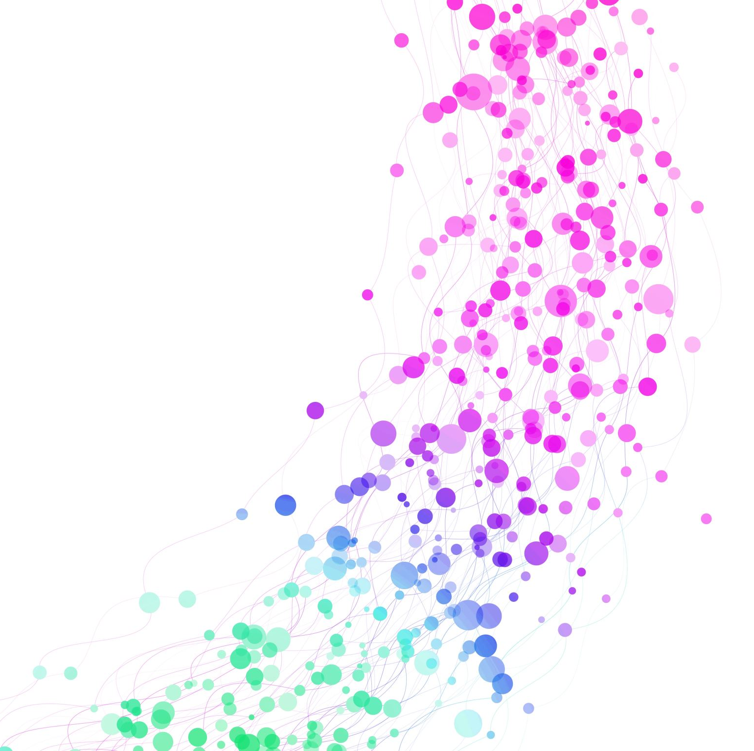
Exploring the NCBI E. coli pangenome functions
Cabreiro Lab retreat
Daniel Martínez Martínez

Slide 2
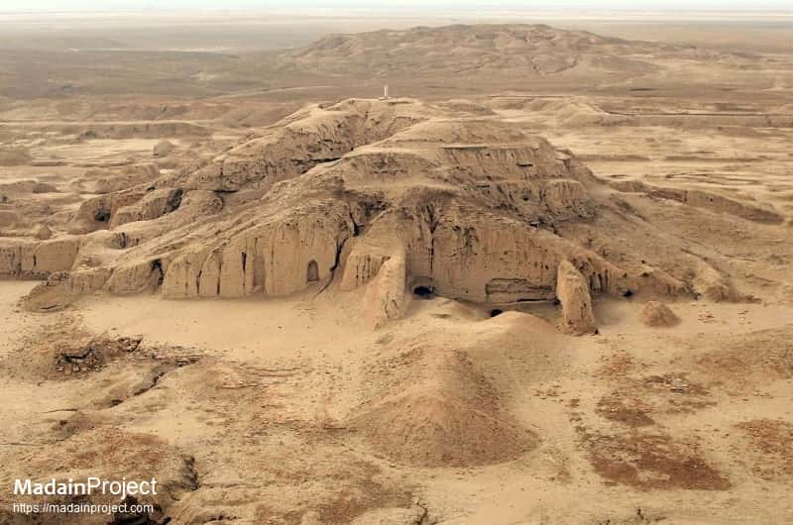
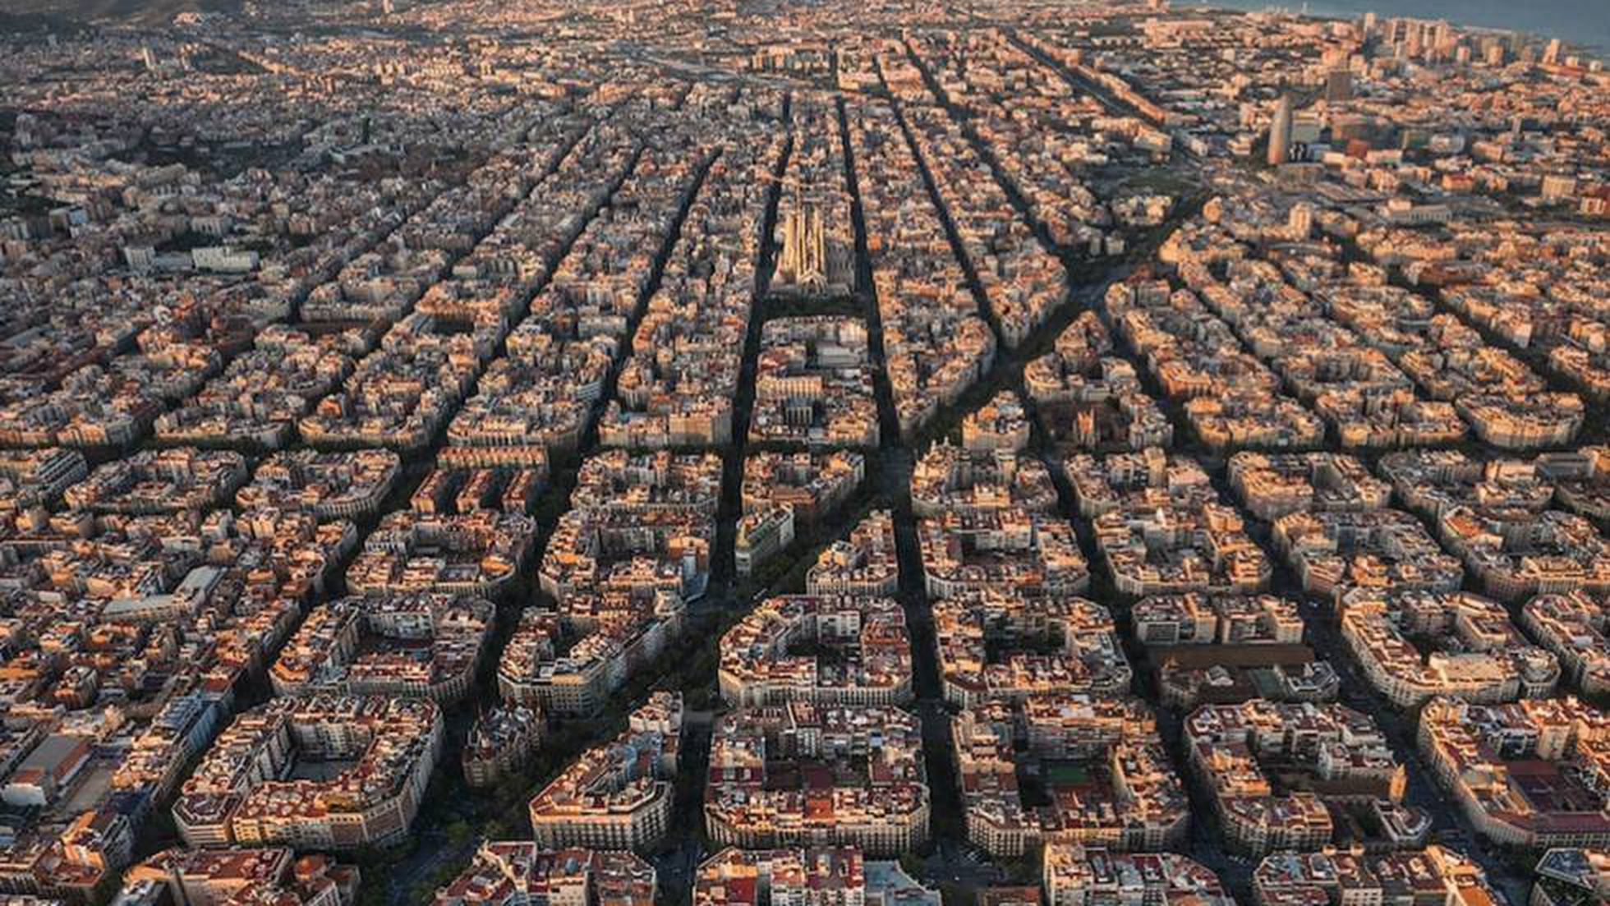
Previously on…
Re-doing functional profiling for all the E. coli strains present in NCBI
From ~750 to more than 28000 strains
Uruk (~3500 BC)
Barcelona (2023)
50K people
1.6M people

Slide 3

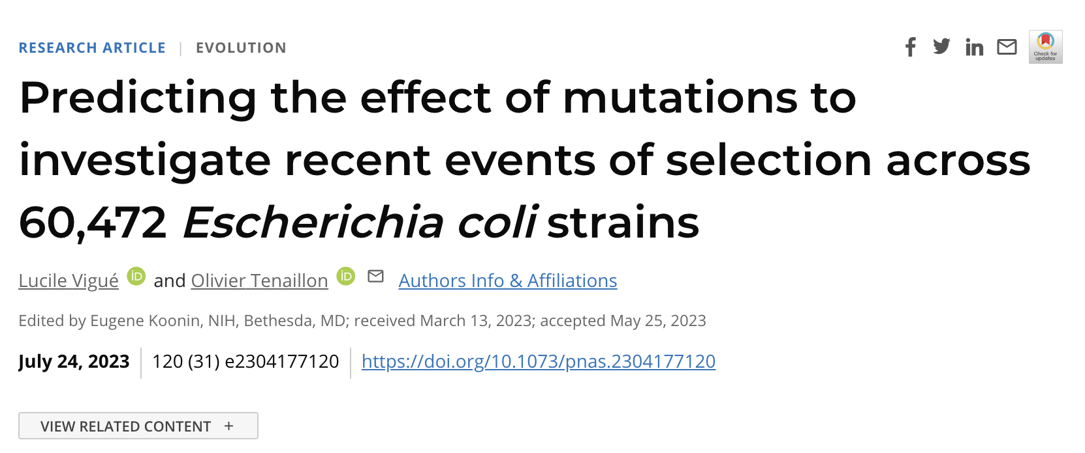

Slide 4
What is an E. coli
What is a bacterial species?
How does it evolve?
How is it maintained?

Slide 5
What is a bacterial species?
Multiple definitions:
Sequence thresholds
Phylogenetic concept
The Stable Ecotype Model (SEM)
The Biological Species Concept (BSC)
Mixed model

Slide 6
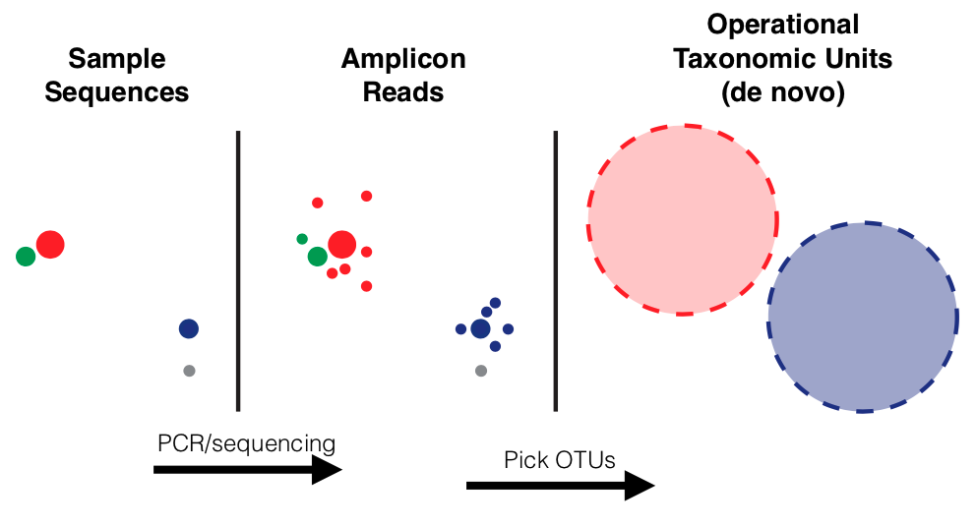
Multiple definitions:
Sequence thresholds
Phylogenetic concept
The Stable Ecotype Model (SEM)
The Biological Species Concept (BSC)
Mixed model
What is a bacterial species?
Sequence thresholds
OTU: Operational Taxonomic Units
97% 16S, 70% genome hybridization
ANI (Average Nucleotide Identity) 95%
Problems:
Several 16S copies that can display >97% divergence (Thermoanaerobacter terngcongensis)
Low resolution in 16S (Prochlorococcus are single group with 16S but diverse with ANI)
ANI: seq identity can be different across the genome
wikipedia

Slide 7
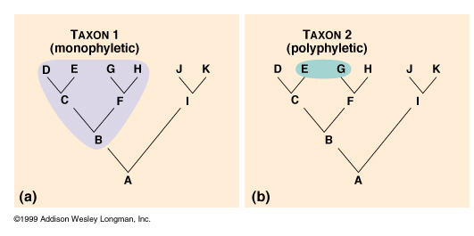
Multiple definitions:
Sequence thresholds
Phylogenetic concept
The Stable Ecotype Model (SEM)
The Biological Species Concept (BSC)
Mixed model
What is a bacterial species?
Phylogenetic concept
Evolutionary relationships between clades
We look for monophyletic clades, but also exclusivity (groups of taxa more related to one another without the necessity of being monophyletic)
Problems:
Computationally demanding
Bias for uneven sampling
Difficult to use the “right” evolution model for tree

Slide 8
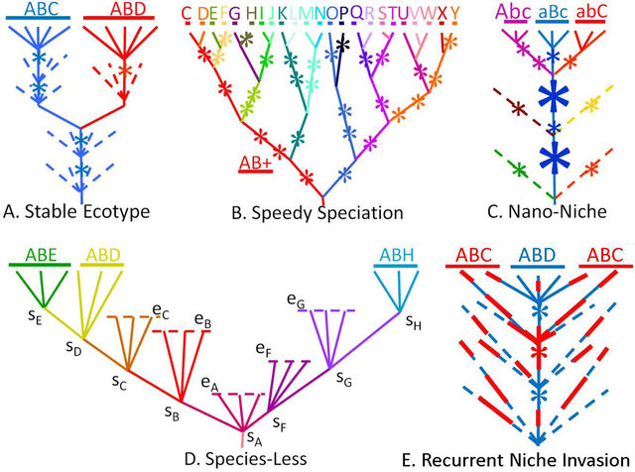
Multiple definitions:
Sequence thresholds
Phylogenetic concept
The Stable Ecotype Model (SEM)
The Biological Species Concept (BSC)
Mixed model
What is a bacterial species?
Phylogenetic concept
Bacterial strains competition for same resources lead to genome sweeps and fixation of a single genome (new species). Produces cohesion through eradication of the other bacteria (and gene flow)
Problems:
1 strain does not reflect the whole species
Stable core genome + scattered accessory genome: a strain can change species!
Genome sweeps are rare in bacteria
Really difficult to gain knowledge from the ecology of organisms
SEM could still be relevant for highly clonal species
Kopac et al, Applied and Environmental Microbiology, 2014
Notes:
a new niche can be just a new metabolite or carbon source for the bacteria
nascent speciation might be constantly occurring but need not lead to full speciation, and this could potentially explain the vast pangenome diversity in bacterial species

Slide 9


Multiple definitions:
Sequence thresholds
Phylogenetic concept
The Stable Ecotype Model (SEM)
The Biological Species Concept (BSC)
Mixed model
What is a bacterial species?
Biological Species Concept
Based on the concept of genetic cohesion through gene flow.
Gene flow == homologous recombination
Enough gene flow can spread alleles to entire population. Gene flow and HGT occur primarily within the same species (machine repair system)
Problems:
Bacteria are not animal/plants, genetic barriers are more diffuse
Unable to define species borders for clonal species
Species 1
Species 1
gene flow
Species 1
Species 2

Slide 10
Multiple definitions:
Sequence thresholds
Phylogenetic concept
The Stable Ecotype Model (SEM)
The Biological Species Concept (BSC)
Mixed model
What is a bacterial species?
Mixed model
Clonal
Recombinant
Species 1
Species 1
gene flow
Species 1
Species 2

Slide 11


Slide 12
Functions – What are the functions within an E. coli?
Metabolic reconstruction from gapseq
Notes:
data from gapseq from the PG strains. Of the genes detected in the genomes, ~30-40% of functions are not known. This is different from the annotation step as this uses something different from Prokka.

Slide 13
even if a gene is annotated, we might not know anything about its function!

Slide 14
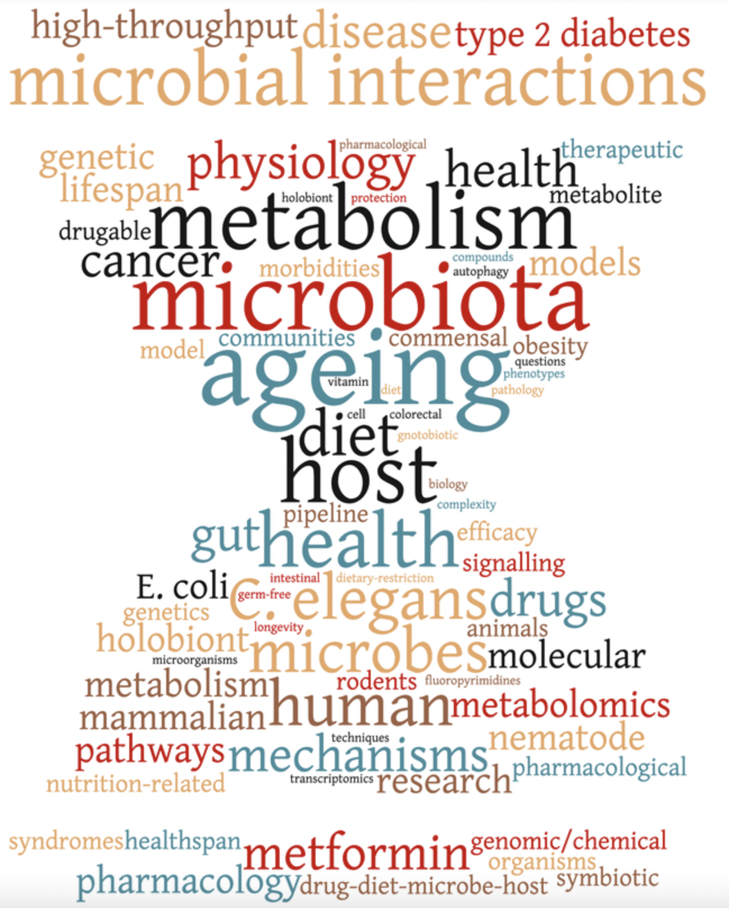

NCBI collection
28867 strains
Cabreiro collection
741 strains
Escherichia coli
29608 strains

Slide 15




Phylogenetic tree
Phylogroups
NCBI collection
28867 strains
ClermonTyping
IQTree
Assemblies
mash
Core genome alignment
Escherichia coli
29608 strains
Quality
Distances
prokka
panaroo/mash
Annotations
Pangenome
Gene P/A
Cabreiro collection
741 strains
panaroo
Reference genes / proteins

Slide 16

Phylogenetic tree
Phylogroups
NCBI collection
28867 strains
ClermonTyping
IQTree
Assemblies
mash
Core genome alignment
Escherichia coli
29608 strains
Quality
Distances
prokka
panaroo/mash
Annotations
Pangenome
Gene P/A
Cabreiro collection
741 strains
panaroo
Reference genes / proteins
proteInfer
CLEAN
deepFRI
AlphaFold 2
ESM
InterPro
eggNOG
Diamond
Function prediction
InterPro analysis
eggnog analysis
progenomes blast
protein structure
GO terms
GO terms
COG categories
protein seq. similarity
protein 3D structure
PCA
t-SNE
UMAP
mapping
PCA
t-SNE
UMAP

Slide 17
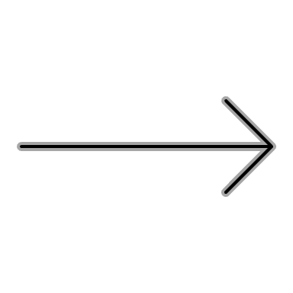

Phylogenetic tree
Phylogroups
NCBI collection
28867 strains
ClermonTyping
IQTree
Assemblies
mash
Core genome alignment
Escherichia coli
29608 strains
Quality
Distances
prokka
panaroo/mash
Annotations
Pangenome
Gene P/A
Cabreiro collection
741 strains
panaroo
Reference genes / proteins
proteInfer
CLEAN
deepFRI
AlphaFold 2
ESM
InterPro
eggNOG
Diamond
Function prediction
InterPro analysis
eggnog analysis
progenomes blast
protein structure
GO terms
GO terms
COG categories
protein seq. similarity
protein 3D structure
PCA
t-SNE
UMAP
mapping
PCA
t-SNE
UMAP

Slide 18
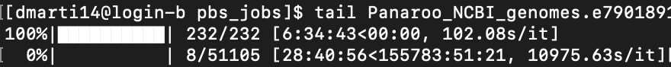
Trying to compute the pangenome calculations with 29K genomes
Using 128 CPUs and 2300gb of RAM memory
However…
The process can take between 28 hours or… 15573 hours
6490 days
almost 18 years

Slide 19
Summary stats – The size of the NCBI pangenome
Core genes | (99% <= strains <= 100%) | 2368
Soft core genes | (95% <= strains < 99%) | 463
Shell genes | (15% <= strains < 95%) | 2639
Cloud genes | (0% <= strains < 15%) | 213822
Total genes | (0% <= strains <= 100%) | 219292
219292 total gene count
125889 reference genes
NOTE: to avoid issues with the multi-mapping of reads, paralogous gene clusters will only be represented once in this reference.

Slide 20
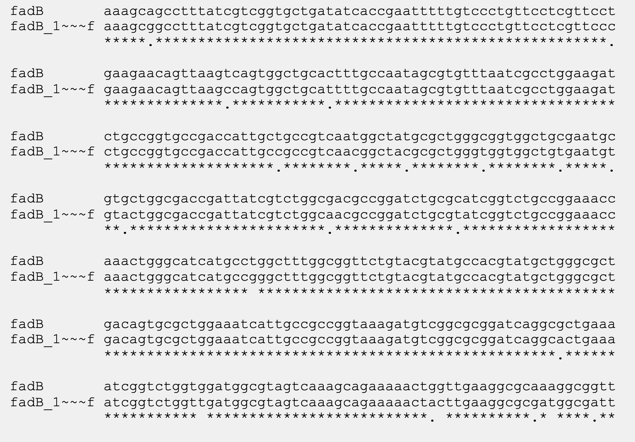
Summary stats – Inflated numbers?

Slide 21
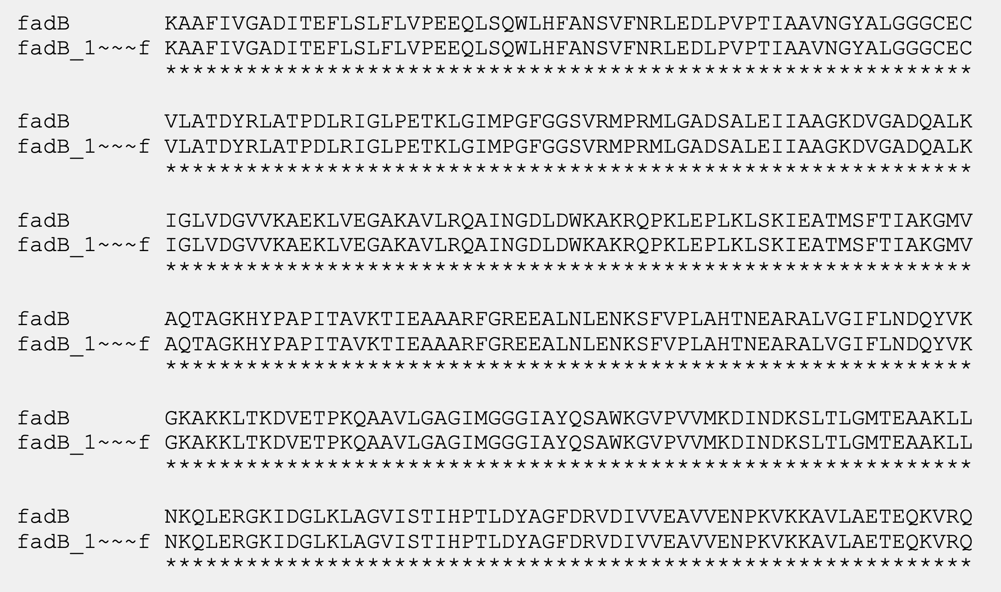
Summary stats – Inflated numbers?

Slide 22
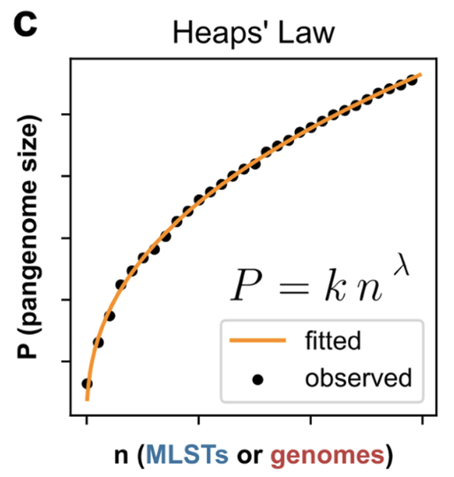
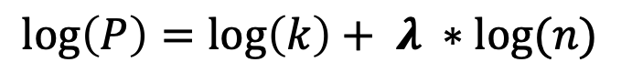
Pangenome size – Heap’s Law
Fitting Heap’s Law with different pangenome sizes
~160K
Hyun et al., 2022
P = 790.71 * n ^ 0.5182
$$\log\left(P\right)=\log\left(k\right)+ λ ∗log⁡(n)$$

Slide 23
Pangenome size – Heap’s Law
~200K
P = 187.36 * n ^ 0.6808
P = 790.71 * n ^ 0.5182
This is proving that final number of total gene families is inflated with this method.

Slide 24
Pangenome size – Accessory size
Cabreiro collection
NCBI collection

Slide 25
Pangenome size – Accessory size
Cabreiro collection
NCBI collection
P = 2416 * n ^ 0.3504
P = 2416 * n ^ 0.3123

Slide 26
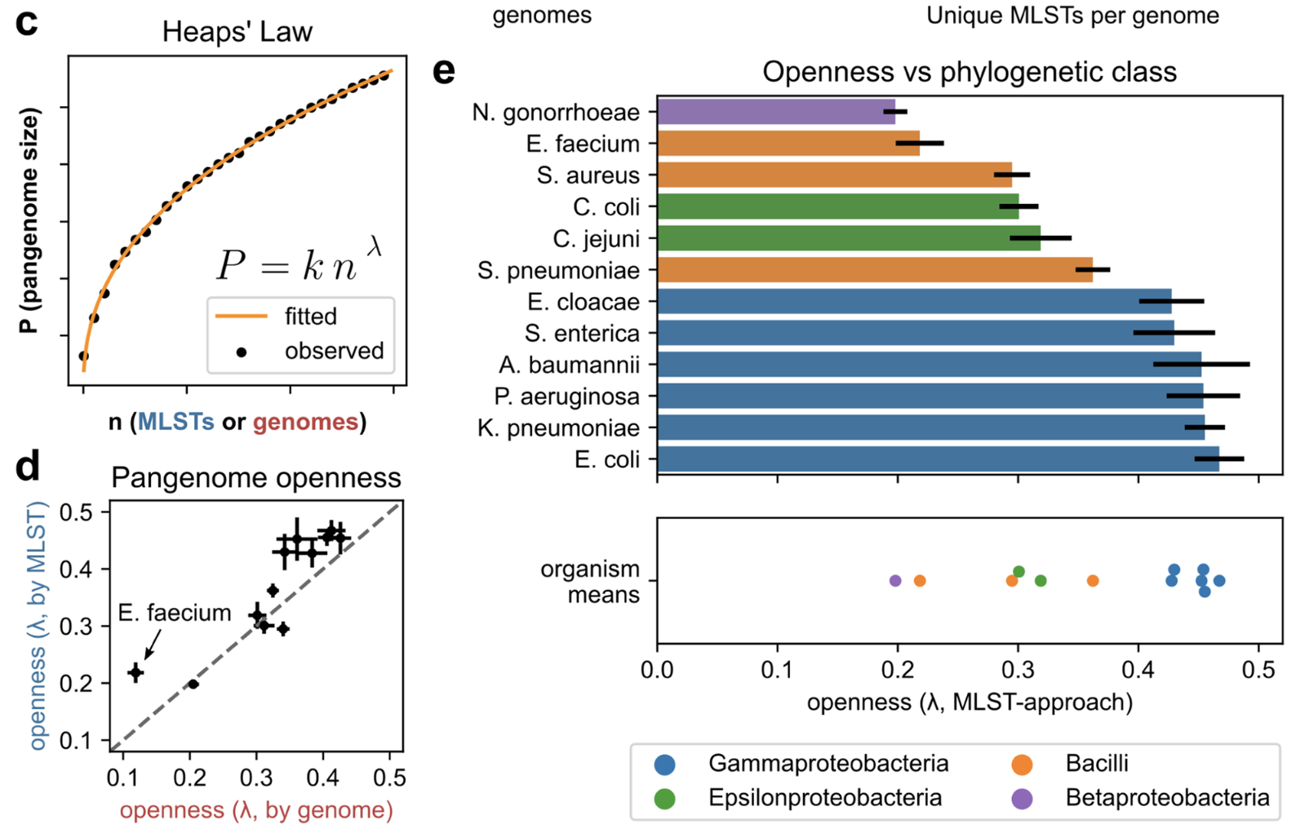
Pangenome size – Accessory size
Hyun et al., 2022

Slide 27
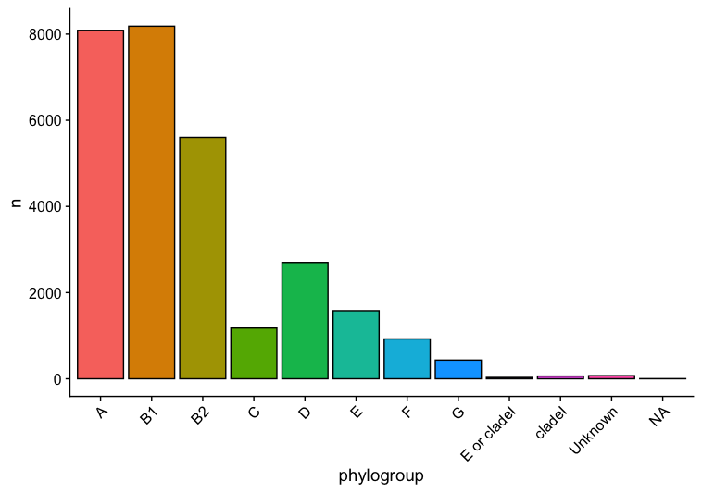
Summary stats – Phylogroups
Phylogroup assignment with ClermonTyping
Important to notice:
NCBI does a great job, >99% of strains belong to E. coli
0.5824 %

Slide 28
Summary stats – Phylogroups
Lab PG
NCBI PG
there are some differences in the general proportion of the phylogroups between both datasets

Slide 29
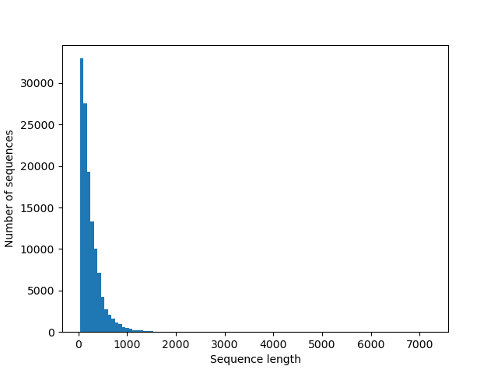
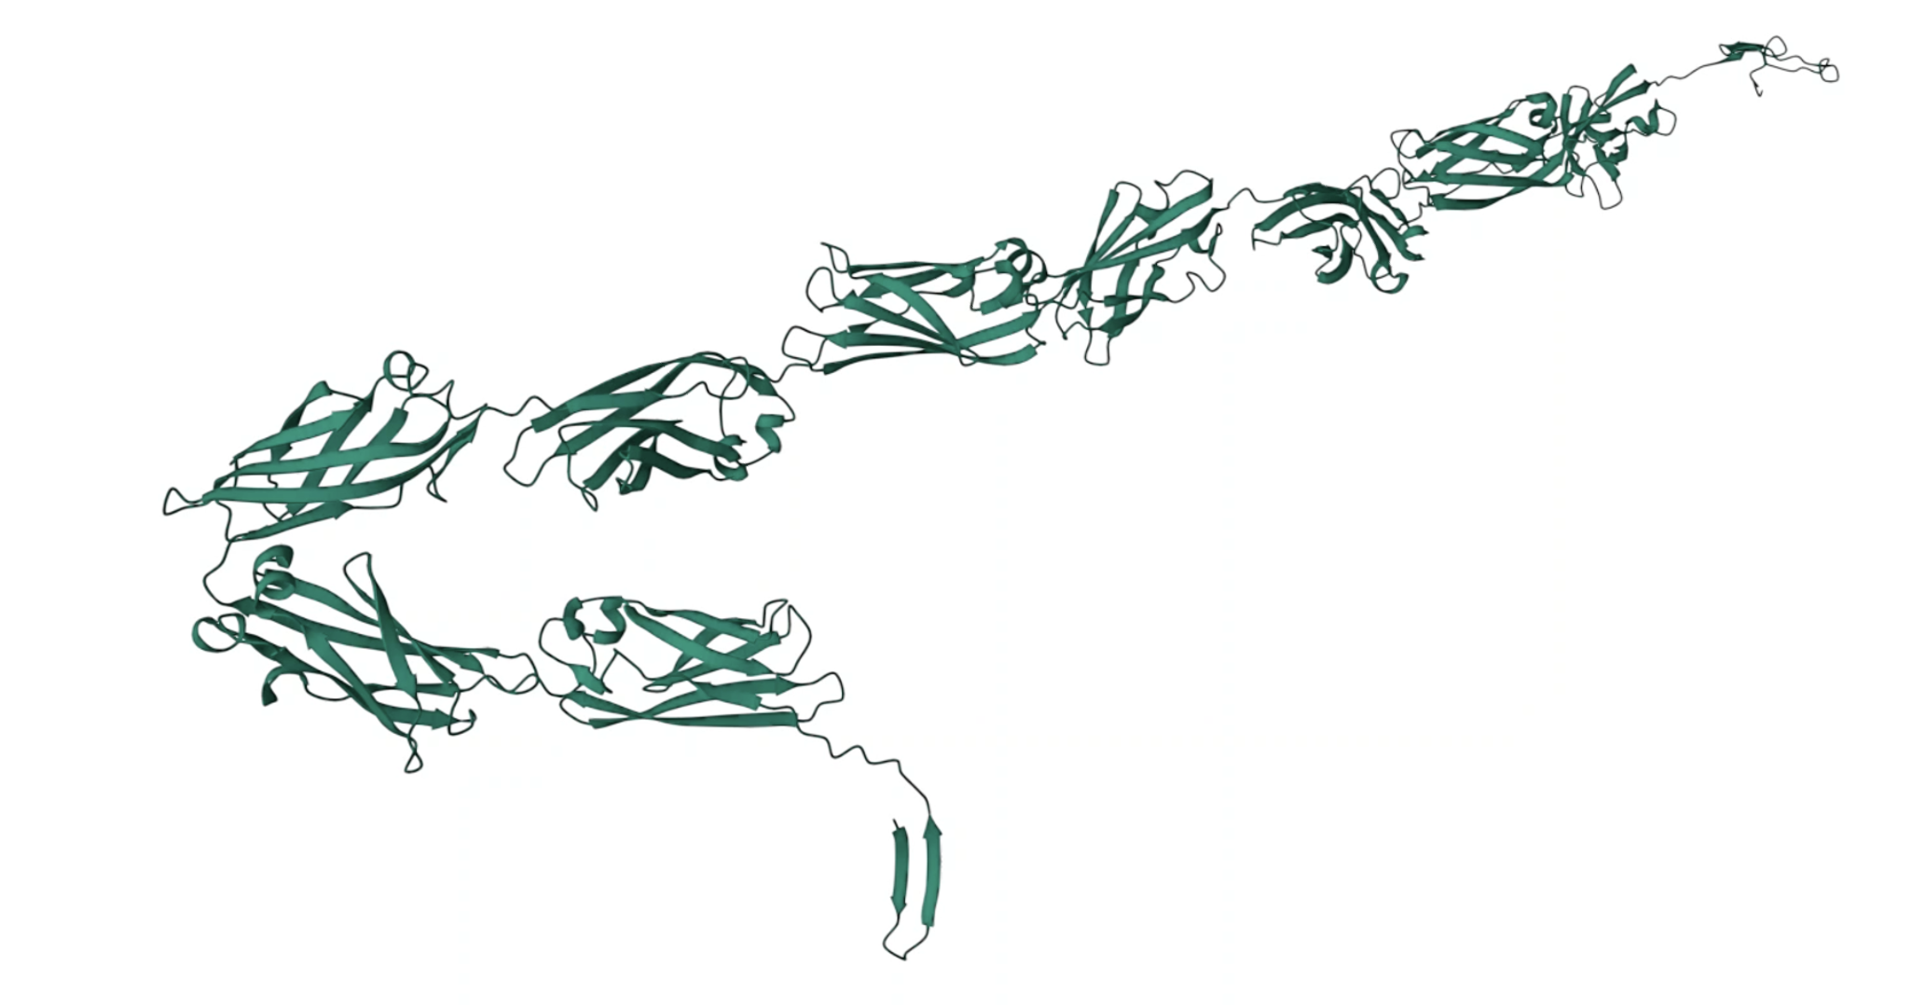
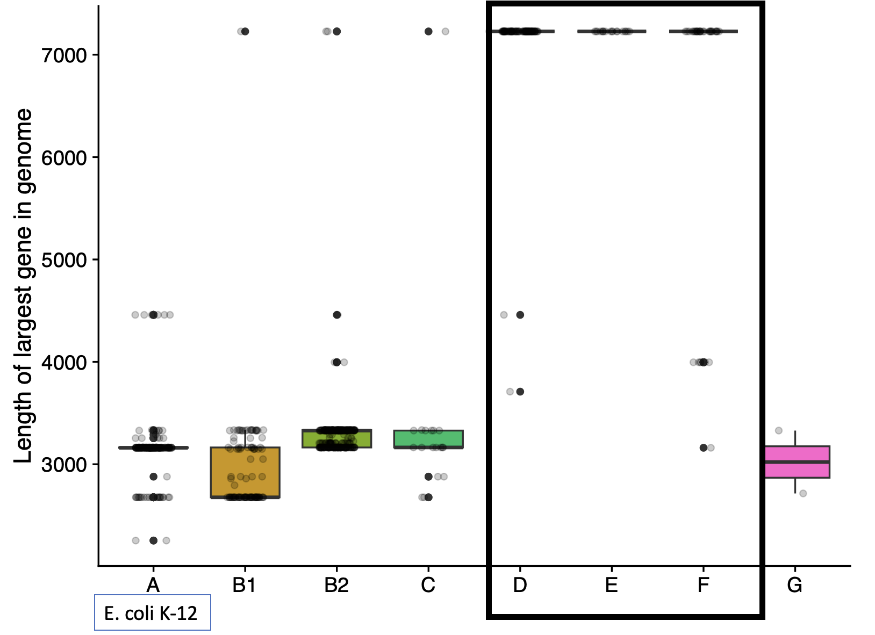
Summary stats – Protein lengths distribution
Proteins with 7227 aa: Ig-like domain proteins
Will it have the same distribution?

Slide 30
Summary stats – Protein lengths distribution

Slide 31
Summary stats – Gene distribution

Slide 32
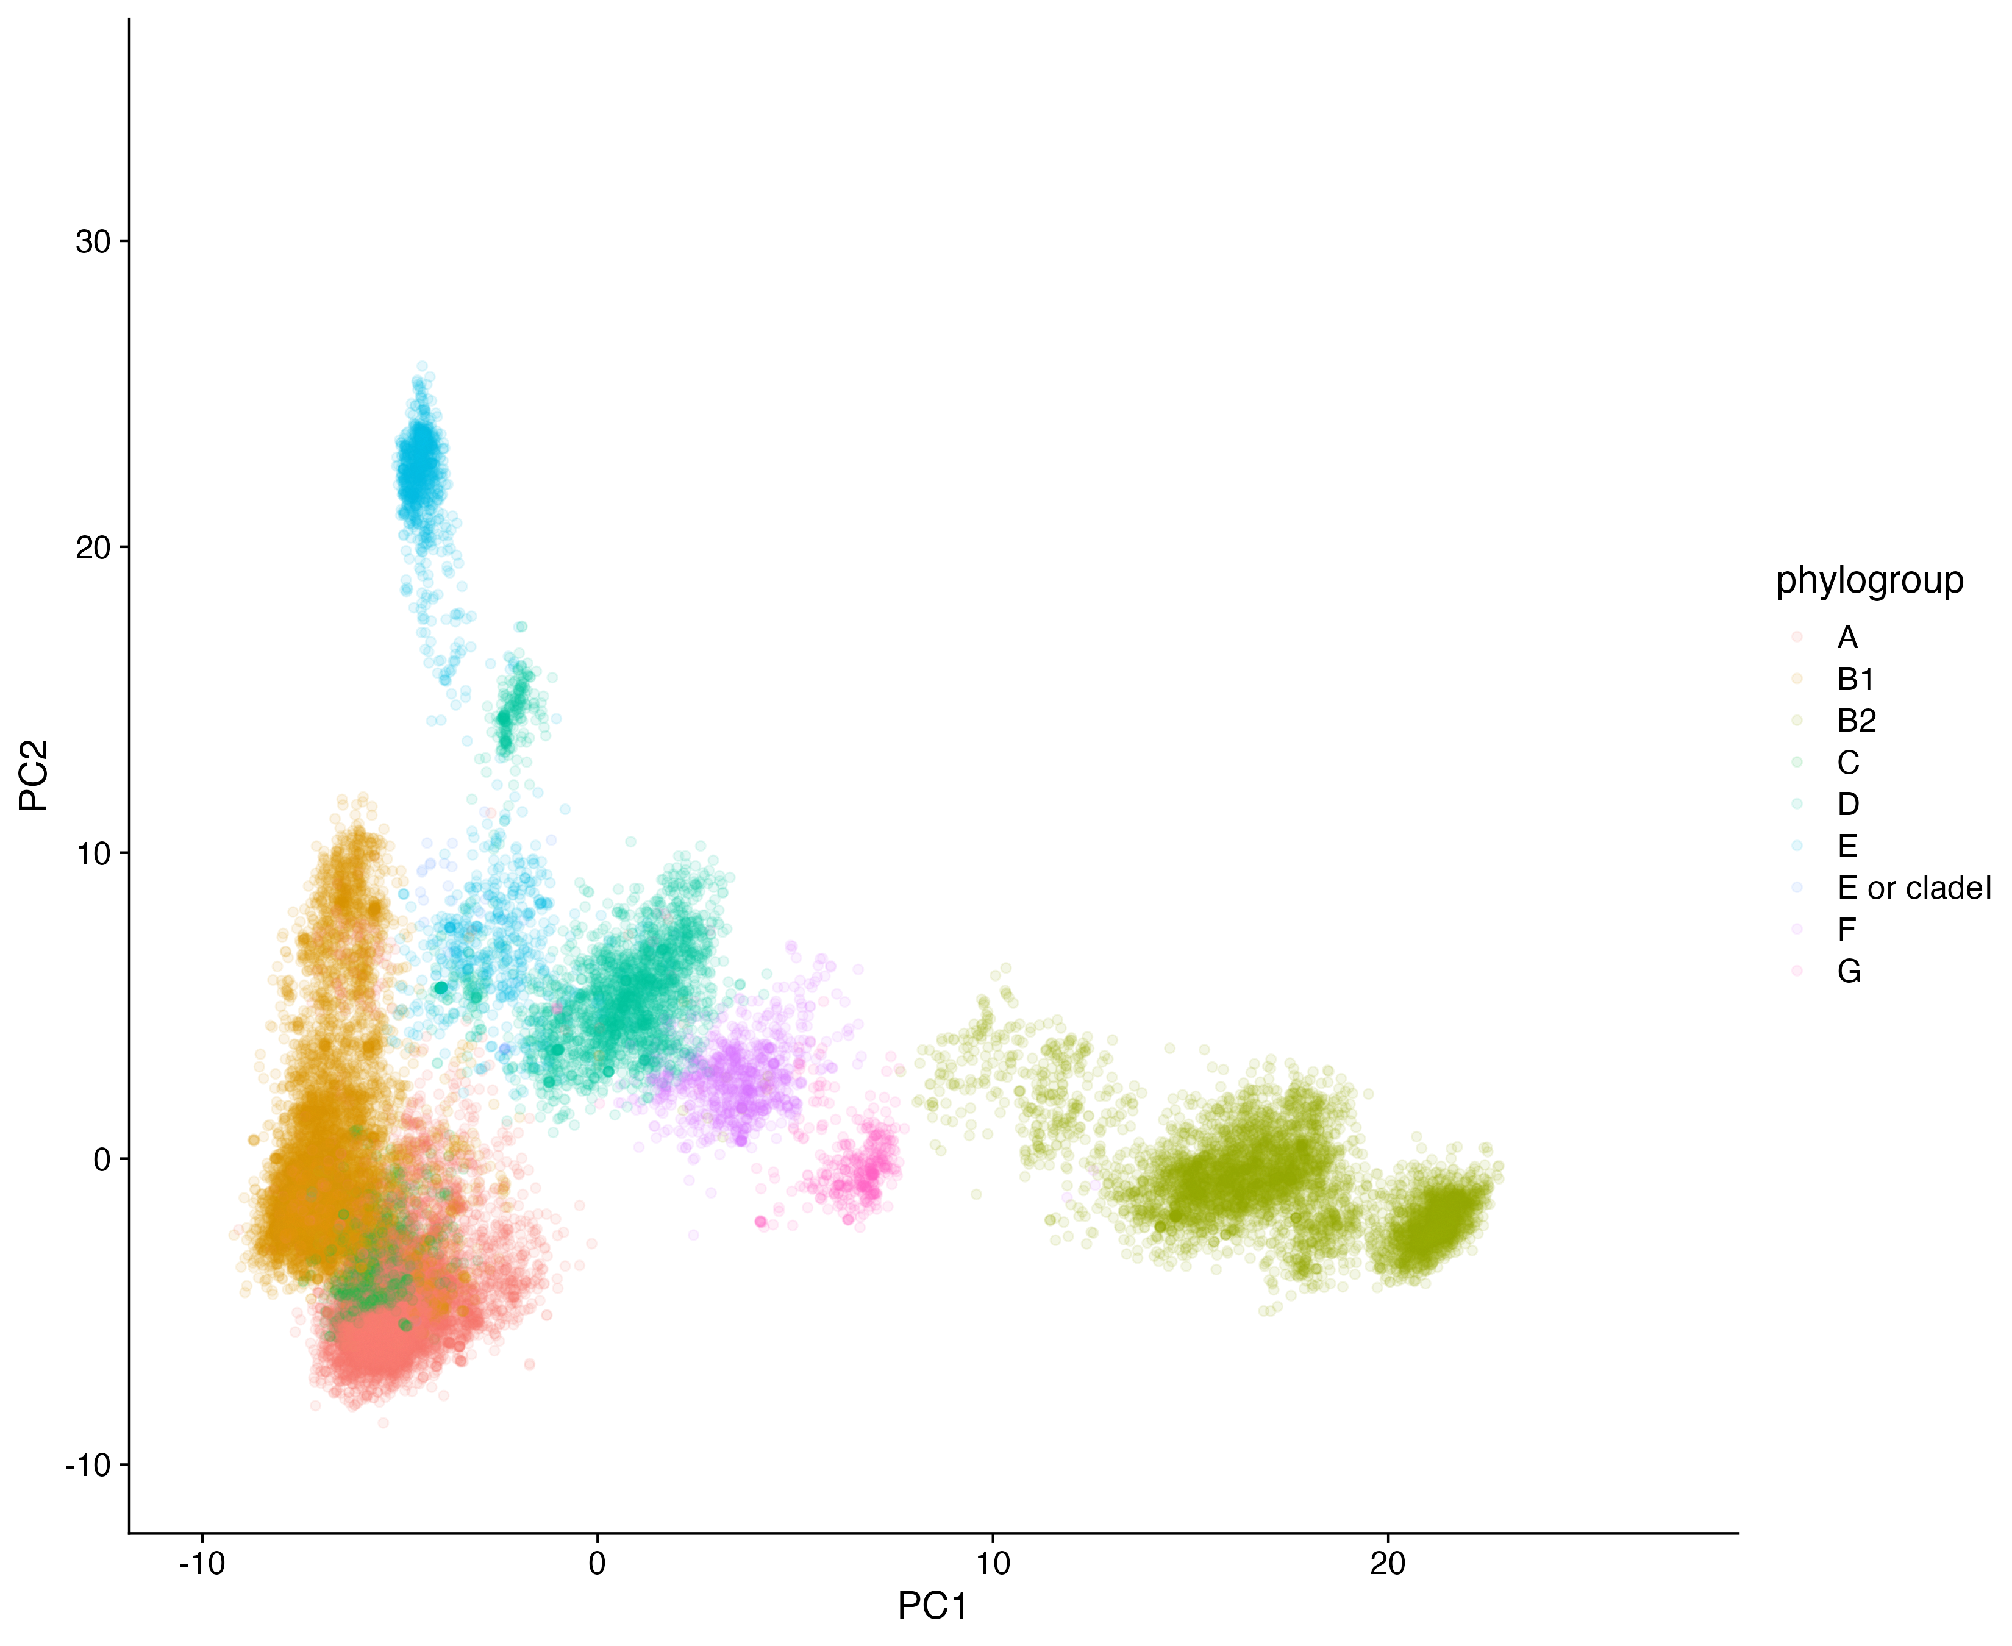
Phylogroup distribution

Slide 33
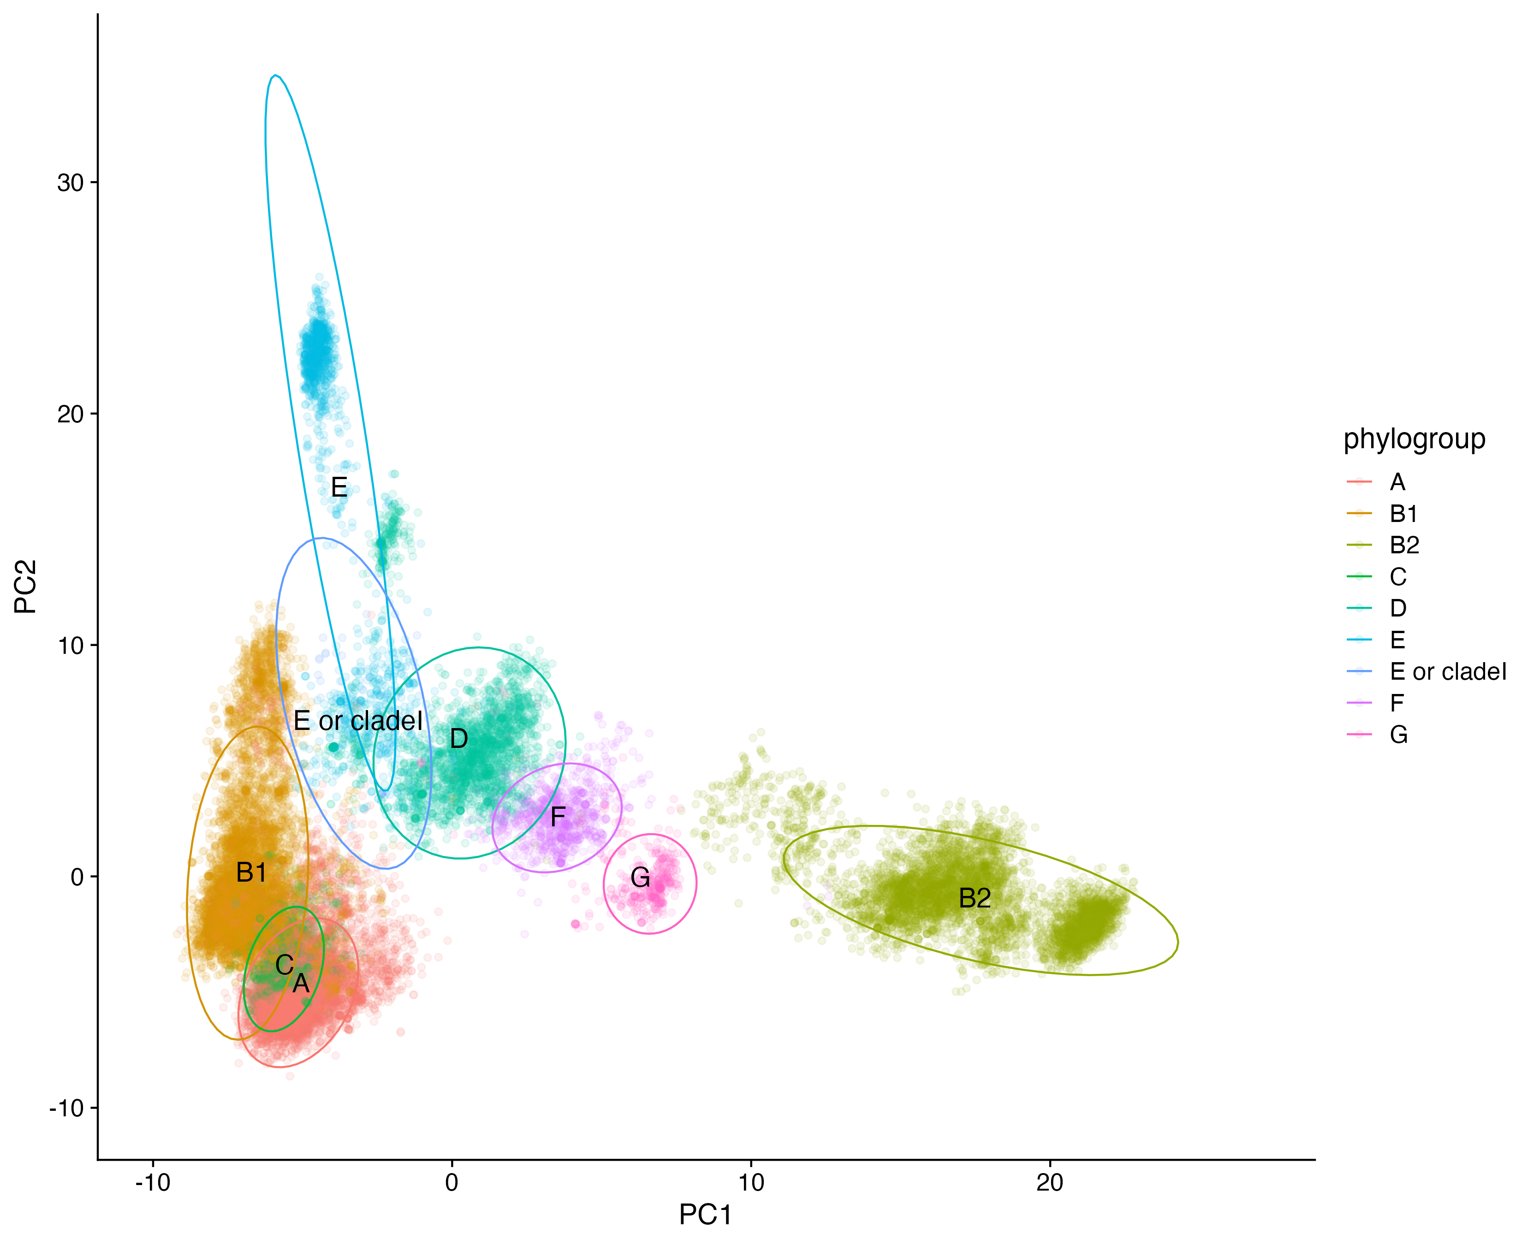
Phylogroup distribution
Notes:
different clustering in B2, and also what the hell is the cluster between E and D

Slide 34
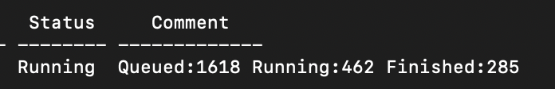
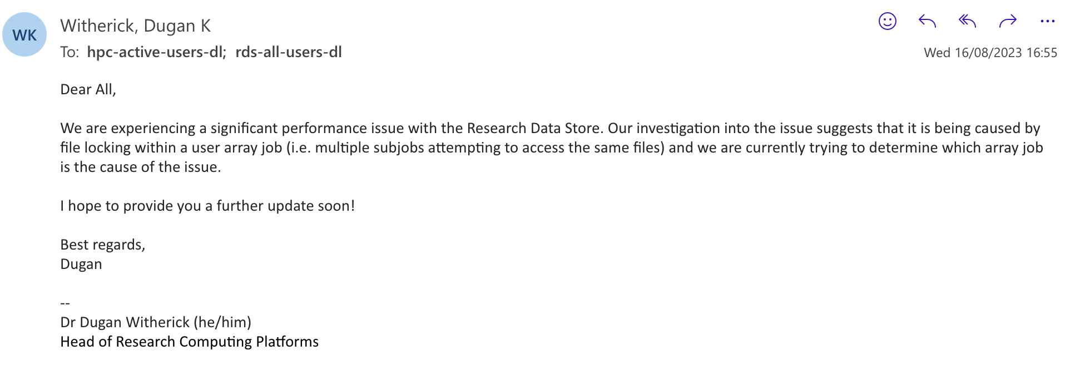

Slide 35
Phylo tree construction
Getting the gene sequences from the PG file is an expensive task
Merging gene sequences and then aligning them is a very expensive task
Solution:
get a few sequences from the core genome (~240 gene families)
Align the sequences per separate
Remove duplicates (orthologs)
Concat the gene sequences into a large file
Build the tree with “fast-tree” option in IQ-Tree

Slide 36

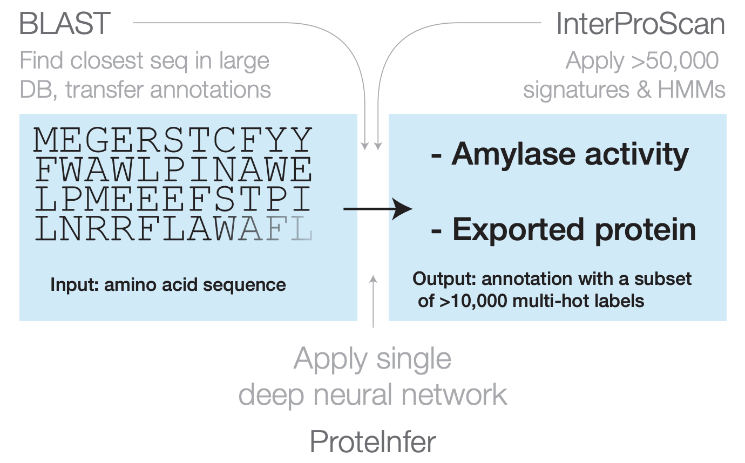
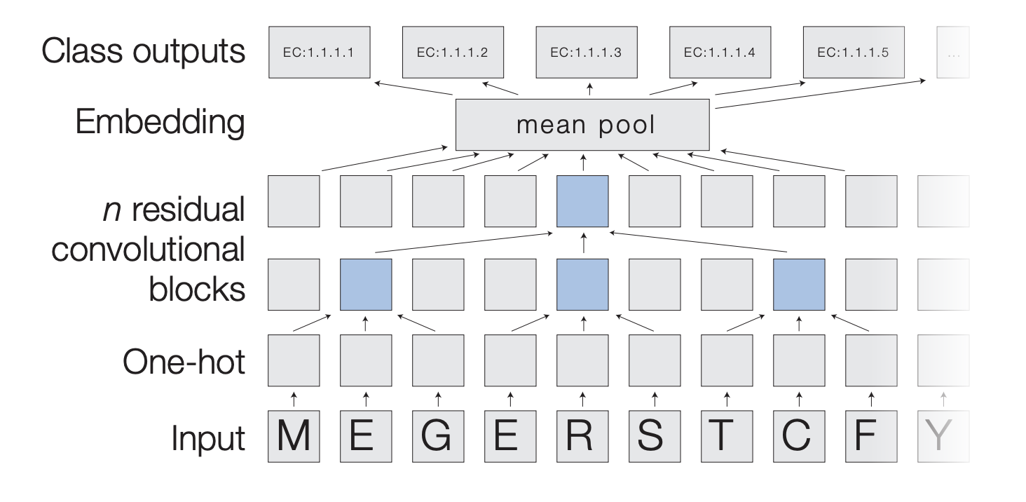
Proteinfer – Functions inferred per protein
Model parameters:
python $HOME/proteinfer/proteinfer.py -i $fasta -o $fasta.tsv --num_ensemble_elements 5 --model_cache_path $WORK/cached_models
Split the dataset into 62 folders of 2000 proteins each. Only accept probabilities higher than 0.4
convolutional neural network

Slide 37
Proteinfer – Functions inferred per protein
Mean = 14
Median = 8

Slide 38
Proteinfer – EC categories
gene family
EC categories
11.5K proteins with EC numbers (~9.1%)
1 | fadB | 15
2 | fadB_1~~~fadB_2 | 15
3 | fadB_1~~~fadB_4~~~fadB | 15
4 | group_186467 | 13
5 | cysG_4 | 12
6 | fadJ~~~fadJ_2 | 12
7 | group_54561 | 12
8 | entE_2~~~entE_1~~~entE_3~~~entE_5 | 10
9 | entE_4~~~entE_1~~~entE_2 | 10
10 | group_55048 | 10
11 | dmlA_1~~~dmlA_2 | 9
12 | dmlA_2 | 9
13 | group_121362 | 9
14 | pgpB | 9

Slide 39
Proteinfer – EC categories – General view

Slide 40
Proteinfer – EC categories – First level

Slide 41
Proteinfer – EC categories – First level

Slide 42
Proteinfer – EC categories – Second level

Slide 43
Proteinfer – EC categories – Fourth level
3.6.4.12 = DNA helicase
2.1.1.72 = Site specific DNA methyltransferase (restriction enzymes)
2.7.13.3 = Histidine kinase
2.1.1.37 = DNA methyltransferase
3.1.4.52 = regulates c-di-GMP levels in bacteria (messenger for many processes)
5.99.1.2 = DNA topoisomerase (5.6.2.1)
3.5.2.6. = Beta-lactamase
2.7.7.65 = regulates c-di-guanylate (messenger)
3.2.1.17 = muramidase
2.7.11.1 = threonine protein kinase

Slide 44
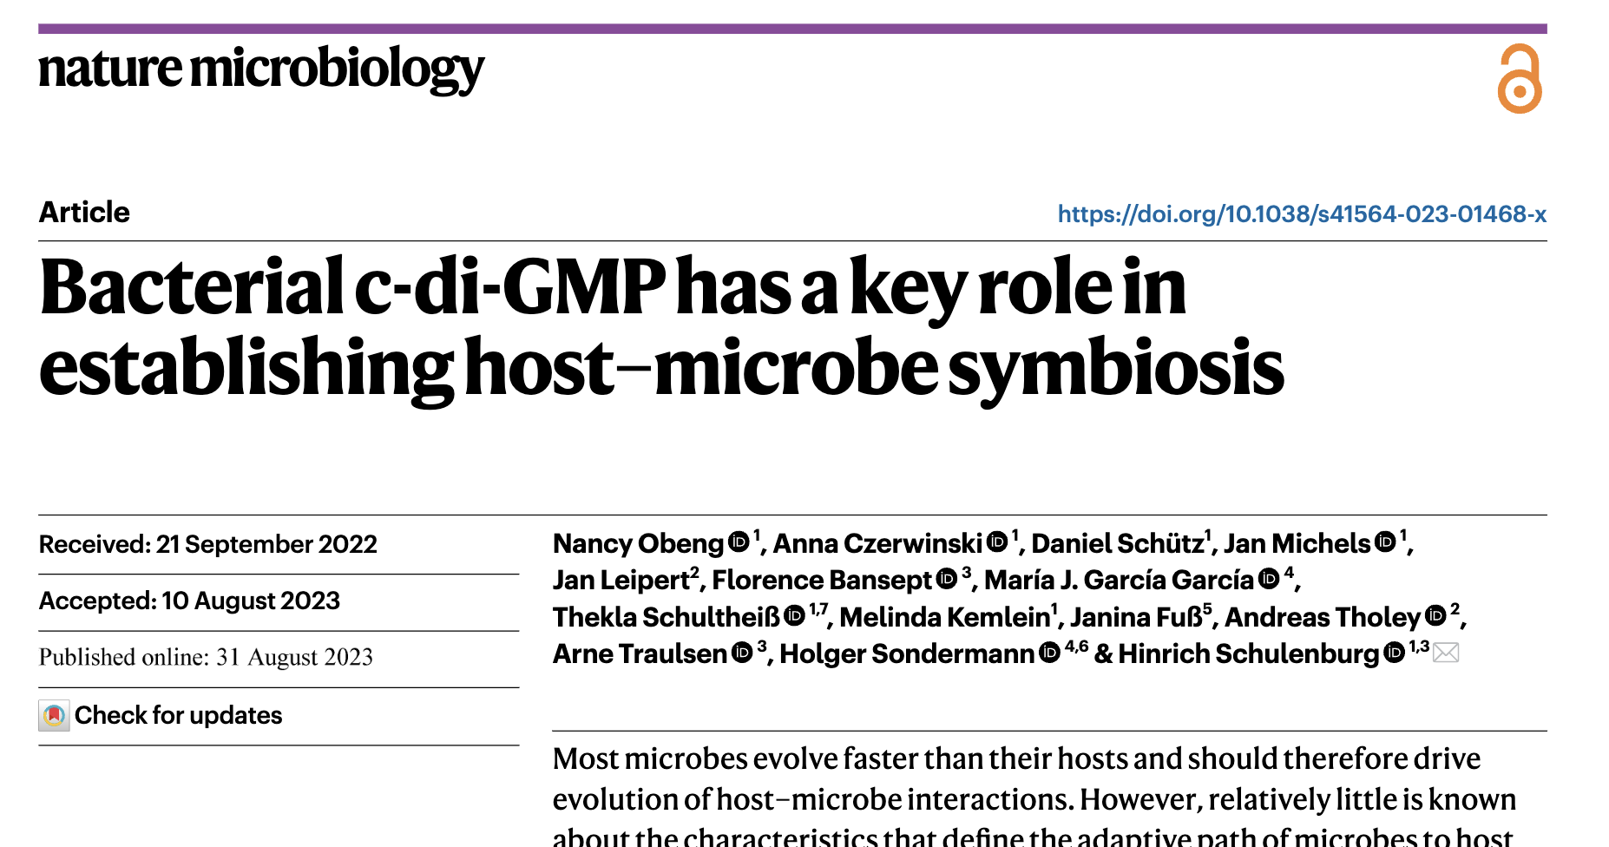

Slide 45
Proteinfer – GO terms overview

Slide 46
Proteinfer – GO terms significant (Chi-squared test)
Expected proportions test! Not raw number of GO terms
Core genome:
biosynthetic processes
amino acid metabolic process
cofactor binding
ion transport
organic acid metabolic process
Cloud/Shell genome:
cell adhesion and projection
DNA integration, recombination, metabolic process, binding (TF)
drug metabolic process
macromolecule metabolic process
organelle
pilus organization
porin activity
symbiotic process
transcription regulator activity
viral process

Slide 47
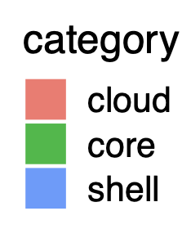
Proteinfer – GO terms significant (Raw numbers)
Example:
We usually have many more categories in the cloud genome independently of the proportions in raw numbers.
predicted_label | description | category | n | total_cats | prop | prop_cat | p.adj | p.stars
GO:0017144 | drug metabolic process | cloud | 598 | 870448 | 0.000687 | 0.1875 | 4.40E-06 | ***
GO:0017144 | drug metabolic process | core | 4 | 4520 | 0.000885 | 0.241527 | 4.40E-06 | ***
GO:0017144 | drug metabolic process | shell | 7 | 3346 | 0.002092 | 0.570973 | 4.40E-06 | ***

Slide 48
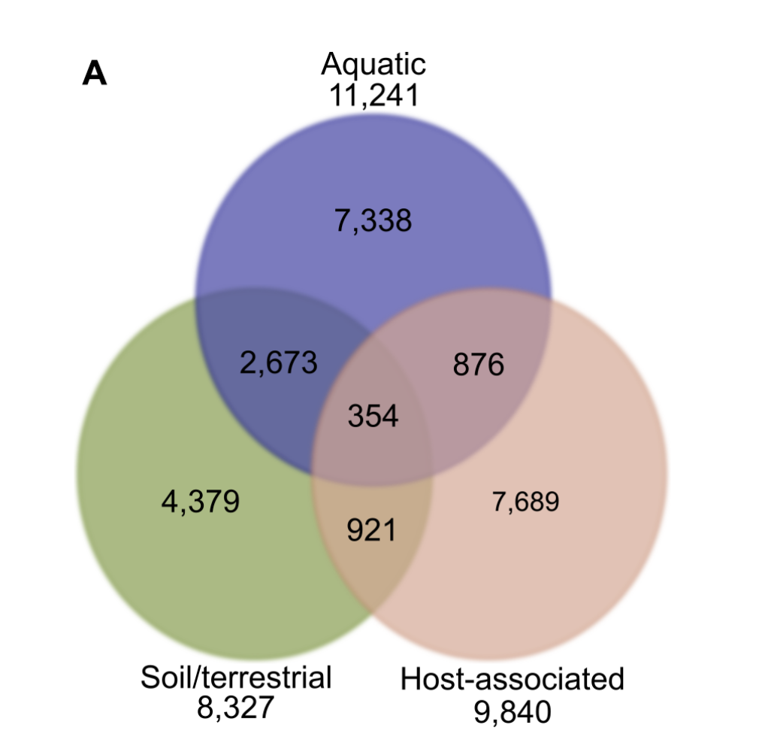
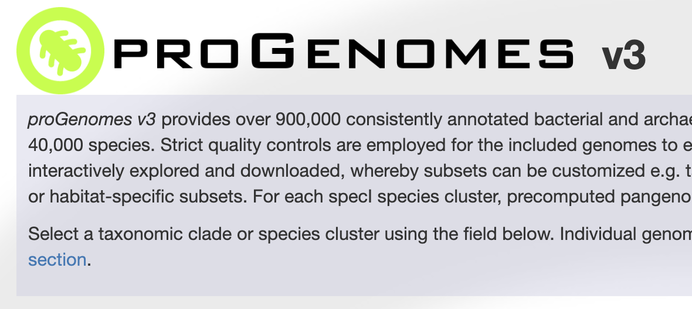
Progenomes – ~900K reference bacterial genomes

Slide 49
Progenomes – Identity thresholds

Slide 50
Progenomes + Proteinfer – Rare proteins GO terms
rare proteins
general distribution (cloud)

Slide 51

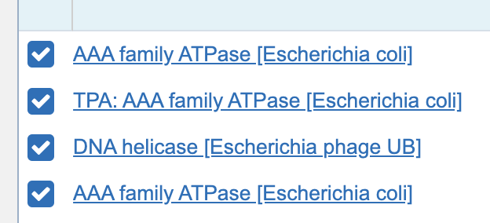
Progenomes + Proteinfer – Discovery of ‘unknown’ proteins? – Helicases
qseqid | pident | length | evalue | bitscore
group_28453 | 49.2 | 626 | 1.12E-189 | 557
group_29979 | 49.6 | 490 | 2.70E-139 | 436
group_46247 | 38.5 | 719 | 7.86E-134 | 418
group_76103 | 31.9 | 445 | 1.07E-38 | 154
uvrB_2 | 46.4 | 332 | 6.56E-82 | 272

Slide 52
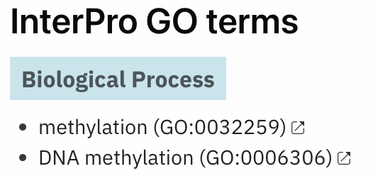
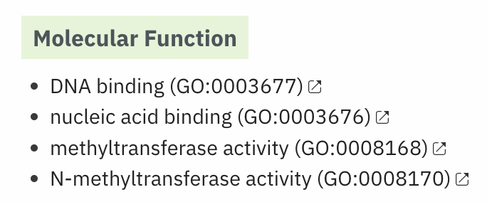
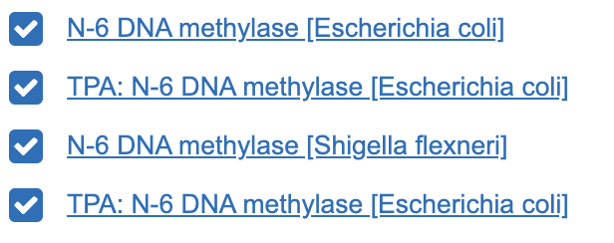
Progenomes + Proteinfer – Discovery of ‘unknown’ proteins? – Methyltransferases
qseqid | pident | length | evalue | bitscore
group_100625 | 39.8 | 650 | 5.99E-128 | 400
group_111983 | 42.9 | 254 | 2.72E-52 | 182
group_141344 | 39.5 | 650 | 1.93E-129 | 404
group_175425 | 39.8 | 650 | 5.99E-128 | 400
group_72509 | 45.2 | 573 | 2.51E-170 | 505
group_79621 | 44.5 | 290 | 5.72E-58 | 205

Slide 53

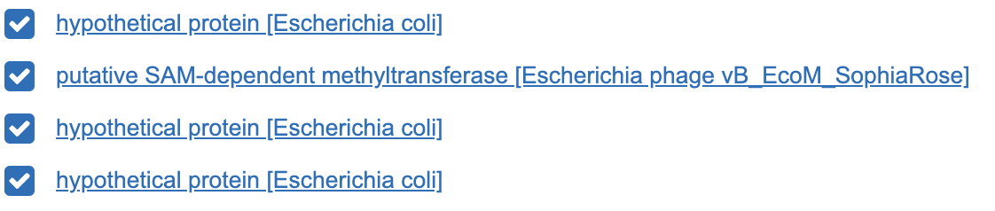
Progenomes + Proteinfer – Discovery of ‘unknown’ proteins? – Methyltransferases
qseqid | pident | length | evalue | bitscore
group_100625 | 39.8 | 650 | 5.99E-128 | 400
group_111983 | 42.9 | 254 | 2.72E-52 | 182
group_141344 | 39.5 | 650 | 1.93E-129 | 404
group_175425 | 39.8 | 650 | 5.99E-128 | 400
group_72509 | 45.2 | 573 | 2.51E-170 | 505
group_79621 | 44.5 | 290 | 5.72E-58 | 205

Slide 54
Plenty of stuff to do…
There are tons of analysis to do with all this information:
MLST analysis of strains
Fix list of reference genes, remove sequences with high similarity
Run protein structure prediction (with AlphaFold2, ESM or others)
EggNog functions analysis
Functional space of proteins
Map functional space with structural space
functional space
structural space

Slide 55

Any questions?

